Slide 1

A Time Machine for Information: Looking Back to Look Forward
EPL646: Advanced Topics in Databases
Looking Back to Look Forward. Xin Luna Dong, Anastasios Kementsietsidis, and Wang-Chiew Tan. 2016. A Time Machine for Information: SIGMOD Rec. 45, 2 (September 2016), 23-32. DOI: http://dx.doi.org/10.1145/3003665.3003671
By: Maria Igarievna Maslioukova(migari01@cs.ucy.ac.cy)

Slide 2
Presentation Outline
Motivation
Temporal Databases
Extraction
Record Linkage
Cleaning and Fusion
Conclusions

Slide 3

Motivation
“The longer you can look back,
the farther you can look forward.”
— Winston Churchill
Notes:
Intrigue scientists to develop a time machine for information that will help people “look back” to “look forward”.
Look back to look forward: study the past -> learn from previous mistakes/ successes -> avoid/apply now and in the future
Record and preserve history accurately

Slide 4
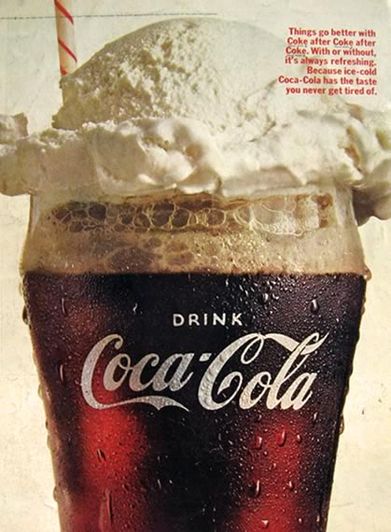

WHY???
Understand trends
Notes:
Understand and describe trends over time
Why ice cream float was popular in 1910s?
What caused the Wall Street crash?
Why most people believed earth was ﬂat versus spherical?
What will the weather be like tomorrow?

Slide 5

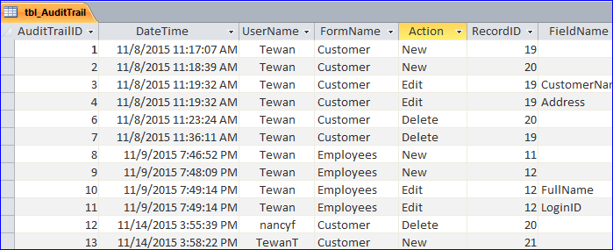
WHY???
Rollbacks and Audit trails
Notes:
Recover database or roll back to a previous consistent state
Records that provide documentary evidence of a sequence of activities (can be used as evidence in court)
Internet Archive keeps, periodically, a snapshot of most webpages on the Web

Slide 6

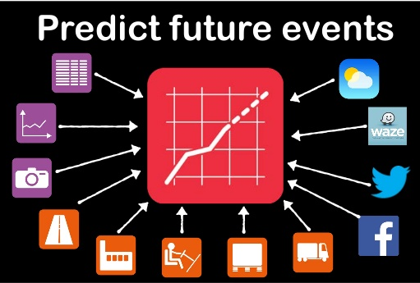
WHY???
Predict the future
Notes:
Use historical data to create knowledge -> try to predict the future
Already applied in weather forecast and stock value prediction

Slide 7
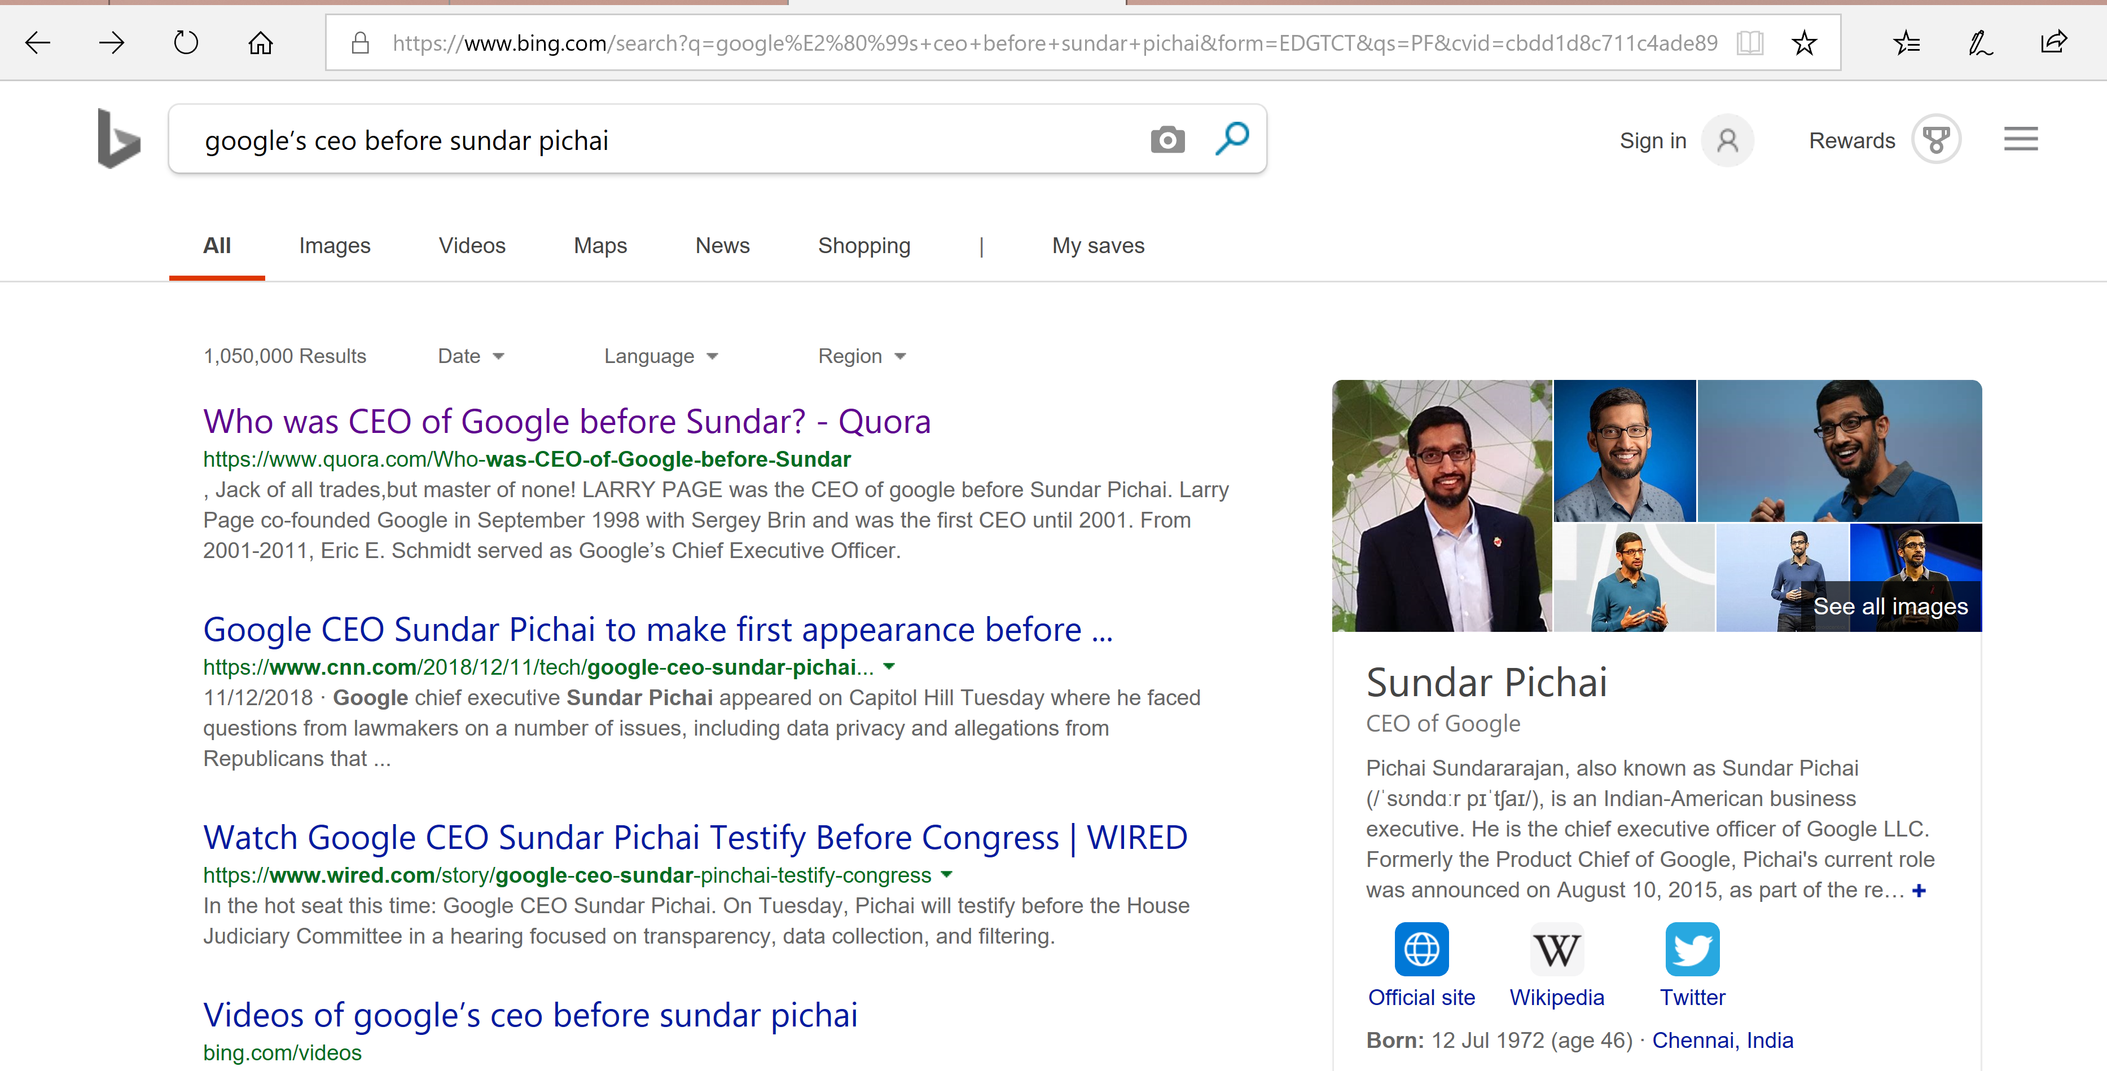
WHY???
Search over historical/long/temporal data
Notes:
Lots of data on the Web
Understand when facts are true ->summing quantities and linking related entities
Develop a complete understanding of the history of an entity (i.e., a person, a company, a music genre, a country)
Query on historical data and getting wanted answer
Ex. “Google’s CEO before Sundar Pichai”. -> requires going back in time
Currently articles about Sundar Pichai ->only after reading through some articles you can pinpoint that it was Larry Page.

Slide 8
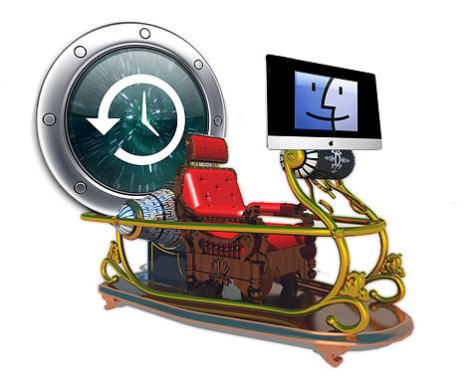
Characteristics of Time Machine
Interpreting data
Information extraction
Time-aware
Scalable
Inter-operate with heterogeneous sources
Notes:
text extraction rules or techniques to extract structured temporal data from data sources.
Transforming and cleaning long data into something meaningful remains a difﬁcult and manual task
map and organizing facts regarding different aspects or properties of an entity together
resolve conflicting temporal data of an entity
understand the valid time period of a fact, trends and perform analytics
search and query facts for a particular time period
perform these tasks at scale
collect information from a large number of data sources, each containing lots of data
repeated process as new datasets are discovered
further enrich knowledge of entities over time, when new versions of the same datasets are available.
extracting information from different types of(heterogeneous) sources,
diverse in their structure and quality

Slide 9
Presentation Outline
Motivation
Temporal Databases
Extraction
Record Linkage
Cleaning and Fusion
Conclusions

Slide 10
Temporal Databases (1)
Temporal data is simply data that represents a state in time. (e. g. Rainfall of January, 2019)
The need tracking and querying long data, rollbacks and audit trials, added temporal data management features in relational databases. Also known as temporal databases.
Valid time (application time) : the time period during which a tuple is true, when it first occurred.
Transaction time (system time): when a tuple, and its valid time, were first recorded in the database. The transaction time duration represents the time period which the tuple was true.
Notes:
Two primary notions of time: valid time and transaction time
Valid time, may refer to the past or future regardless of when it was entered into the database.
Transaction time only increases, since the next tuple that is recorded in the database can only occur at a later time than a previous tuple.

Slide 11
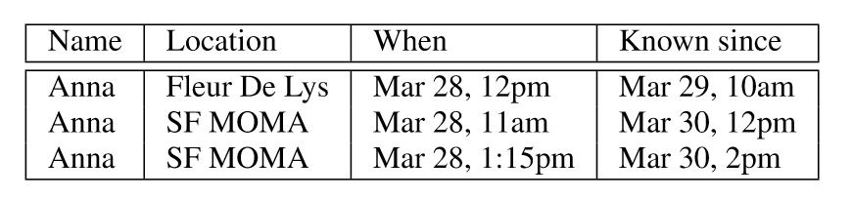
Temporal Databases (2)
Valid time
Transaction time
Notes:
We, as humans, understand that Anna was at SF MOMA from 11am to 12noon, at Fleur De Lys from 12noon to 1:15pm, and then back at SF MOMA from 1:15pm onwards
Without applying logic-> records are insufﬁcient
The conclusion of where and when Anna was, is based on the preference that information with a later known time is preferred to information from an earlier known time (ordered by it), and that Anna can only be at one location at any point in time.
Other preferences (e.g., information from one source is preferred over the other)-> other conclusions
Support user-deﬁned preferences for resolving conﬂicts

Slide 12
Presentation Outline
Motivation
Temporal Databases
Extraction
Record Linkage
Cleaning and Fusion
Conclusions
Notes:
In the next three sections, we will present some existing work on three major components important for such systems.
For convectional (data is tightly constrained, data model) and temporal data.

Slide 13
Extraction (Conv.)(1)
Extraction: understanding text and extracting structured data from it.
“Anna was at restaurant Fleur De Lys on March 28, 12 noon.”
What about:
Anna was at the restaurant at 12 noon?
or
That Fleur De Lys is a restaurant and not a city?
(Anna, location, Fleur De Lys)
(Anna, on, March 28)
Notes:
We can extract data directly from texts (Web), short texts (Tweets), and fairly structured web tables (HTML). Concentrate on Web source.
Notice that not all information might be successfully extracted in the process of extraction.
Extractions are often incomplete.

Slide 14
Extraction (Conv.)(2)
Extraction
+
Richness of the language.
The same thing can be
expressed in multiple ways.
Understanding the semantics of a sentence often requires understanding its context (e.g. other sentences in the same paragraph).
“She ordered pasta.”
==
“Anna ordered pasta.”
Notes:
While extracting, it should consider the following two parameters.
To extract the simple fact that (Anna, ate, pasta) we need to dereference “She” and understand that it refers to Anna. Approaches in information extraction often rely on machine learning natural language processing.

Slide 15
Extraction (Temp.)
Extraction: beyond extracting facts, we want to know the time these facts happened.
Challenges of temporal data extraction:
(a) Identify temporal references in the text
(b) Map a temporal reference to a time point (or interval)
(c) Assign a time point (or interval) to a fact.
Notes:
As we would do with conventional data we want to extract facts about different entities and the time the were valid.

Slide 16
Identify temporal references
Time is expressed in a variety of ways in a text.
“Anna was at restaurant Fleur De Lys on March 28, 12 noon”
“Last week, Anna was at restaurant Fleur De Lys.”
“Anna was at restaurant Fleur De Lys.”
Clear time reference
Explicit
Less obvious reference
Implicit
Notes:
Clear reference: easy to find the time the event happened.
Less obvious: we identify key words that express time.
Explicit: sentences contain words that are associated with time (e.g. day, week, month)
Implicit: past tense of the verb implies that the event happened sometime in the past

Slide 17
Assign a time point
“March 28, 12 noon”
“Last week”
“was”
Straightforward assigning to a time point
We need indication for the week the text was written (or at least when the text was created)
Identify the time the text was written (or is referring to)
Mapping a reference to a time point is hard!!!
Notes:
“March 28, 12 noon” : assuming we know the year that this date is referring to
“Last week” : document creation time resembles the transaction time in temporal databases
“was” : the identified time is an upper-bound for the event.
Most challenging part of temporal information extraction. Usually a combination of machine learning and syntactic analysis is used to achieve that.

Slide 18
Record Linkage (Conv.)
Record linking: identify records that refer to the same entities.
Blocking: partition input records into multiple smaller blocks. Records in different blocks are very unlikely to refer to the same entity.
Pairwise matching: compare every pair of records in a block to decide whether they refer to the same entity or not.
Clustering: partition records from the same block, so that each partition refers to a distinct entity. It examines local pairwise matching decisions.
Notes:
Solutions to the record linkage problem typically include the following three steps.
Blocking reduces the number of pairwise comparison for the subsequent steps. We don’t compare records that we are sure they refer to different entities.
We achieve scalability (i.e. to handle massive data).
Pairwise matching and clustering steps are used to ensure the semantics of record linkage.
Determine whether or not two records refer to the same real-world entity.

Slide 19
Record Linkage (Temp.)(1)
Problem!
Traditional linkage techniques won’t work for temporal data.
For example:
A person may change her name after marriage, change jobs, move to a new home (new address, phone number) and so on.
Another example:
As time elapses, it is more possible to encounter different entities that share the same attribute values. (e.g. name)
value evolution
Notes:
Hence, blindly penalizing low value similarity, thus records that refer to the same entity but at different times will not be matched because of value evolution.
Hence, blindly rewarding high value similarity can wrongly match together records that refer different entities at different times just because they happen to share the same attribute values.
Thus temporal records present need new techniques to perform temporal record linkage. (or evolve the existing ones).

Slide 20
Record Linkage (Temp.)(2)
Observations about temporal records
Entities typically evolve smoothly, and usually only a few attributes change at a time.
Values of an entity do not change erratically and they rarely change back and forth.
If the data set is fairly complete, records that refer to the same entity have continuity, or similarity in time gaps between adjacent records.
Time decay & Two-stage temporal clustering
Notes:
Solution: introduce time decay in pairwise matching and change clustering to a two-staged clustering

Slide 21
Time decay (1)
Use: reduce the impact of older records on the analysis and can capture the impact of time elapse on attribute-value evolution.
Two types of decays
Disagreement decay is the probability of an entity’s attribute to change its value over a time period.
Agreement decay is the probability of two distinct entities having the same attribute value over a (long) time period.
Notes:
Disagreement decay : reduces the penalty for value evolution
Agreement decay: reduces the reward for value agreement, over a long time period
Two extensions for time decays.
Recurrence rate: probability of the same value re-occurring for an entity attribute. A value may change back at a future time point. For example, a person may return to the same afﬁliation.
Transition probability: Shows the likelihood of a value transitioning to other values. It is compute across different pairs of values. For example, it is more likely for an “Associate Professor” to transit to “Full Professor”, than “Accountant”.

Slide 22
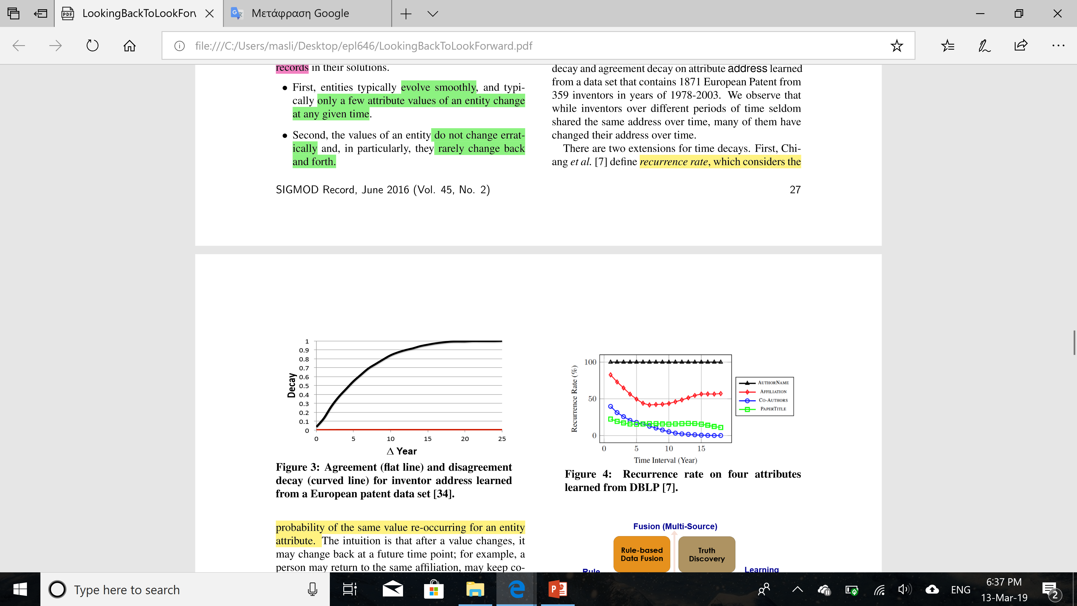
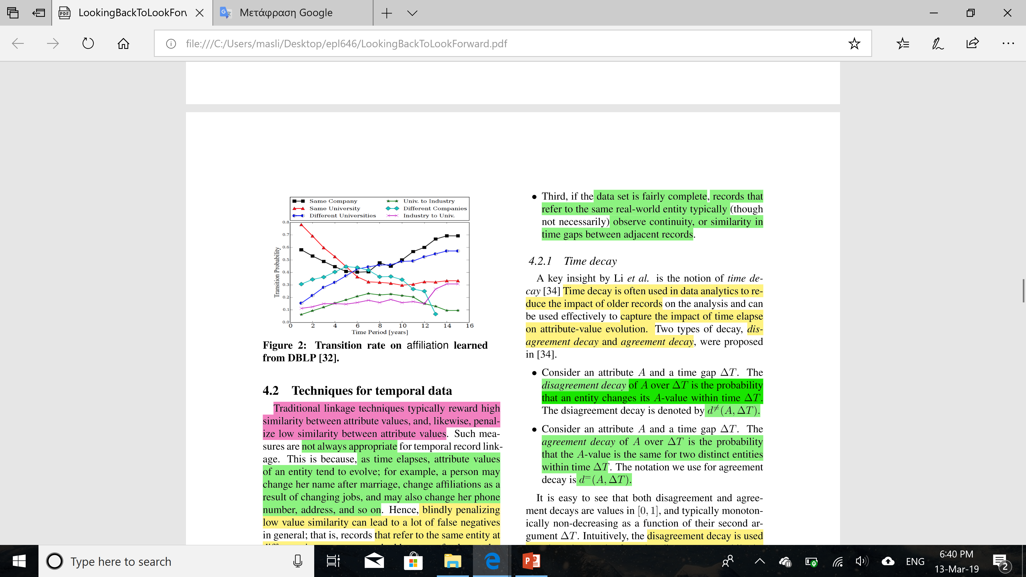
Time decay (2)
Notes:
Figure 3: inventors over different periods of time share the same address, while many of them have changed their address over time.
Figure 2: shows the transition rate between different types of values for afﬁliation.

Slide 23
Two-stage temporal clustering
Two-stage clustering: for correct record linkage we need to consider the time order of records.
Stage 1: Considers the records in temporal order. Compares a record with the existing clusters and computes a probability of merging them. After processing all records, it assigns a record to the best matching cluster.
Stage 2: Compares a record with clusters that were created later on. The comparisons take into account record continuity and clusters are adjusted based on these comparisons
Notes:
Stage 1: may place a record into multiple clusters, if it believes that record contains stale data.
Stage 2: merges clusters if it decides that the probability of transition is high and ignores clusters consisting of only stale records.

Slide 24
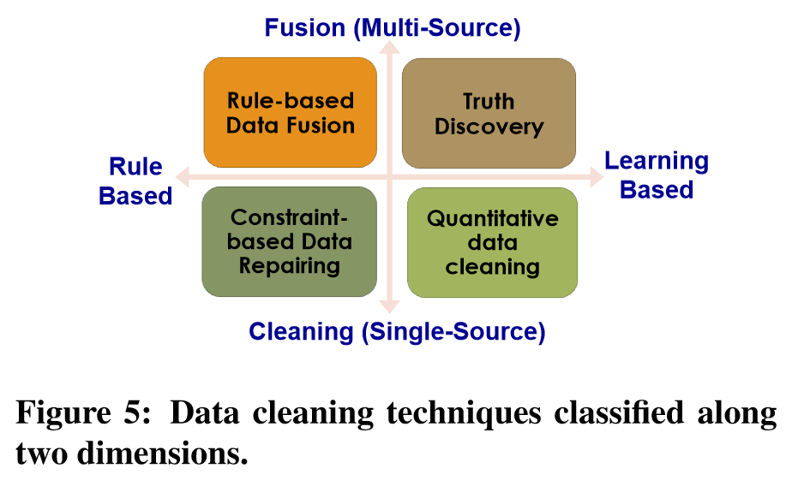
Cleaning and Fusion (Conv.)(1)
Cleaning: decide which piece of data, from a single source, is incorrect compared to reality and ﬁx it.
Fusion: merging and cleaning data from multiple sources.
Notes:
1st dimension: whether we consider data from a single source or over multiple sources
2nd dimension: whether data cleaning is rule-based or learning-based.

Slide 25
Cleaning and Fusion (Conv.)(2)
Rule-based data cleaning–Constraint-based data repairing: Constraints are used to find the relationship between data values and applies data cleaning.
Learning-based data cleaning–Quantitative data cleaning: Statistical techniques detect outliers of the data and replace them.
Rule-based data fusion–Declarative data fusion: statistic analysis of entities values is used for resolving conflict among multiple sources.
Learning-based data fusion–Truth discovery: applies machine learning models that consider trust worthiness of sources and copying relationships between them.
Notes:
When relationships are violated, the data are typically cleaned (or repaired) by applying the smallest set of changes to the data values such that the constraints are no longer violated.
It tries to make the cleaned data have a close distribution to an ideal data set;
however, is not guaranteed to be logically consistent.
Computes the average value from a list of values, ﬁnds the most popular value or the latest update
ﬁnd the truths that are consistent with the real world

Slide 26
Cleaning and Fusion (Temp.)(1)
Cleaning: decide which piece of data is incorrect for the claimed time point (or period) and fix it.
We must consider:
the update history from data sources hint changes of entities. (Information about a restaurant may be removed because the restaurant is closed.)
some attributes have partial order. (Single status should appear before married. Likewise for divorced.)
Notes:
As mentioned before, the values can evolve over time
We will see how the data-cleaning techniques can be extended for temporal data, besides the learning-based data because no quantitative cleaning strategies for temporal data are known.

Slide 27
Cleaning and Fusion (Temp.)(2)
Rule-based data cleaning - data currency: considers data without timestamps as input, and aims at ﬁnding the up-to-date values, based on the data semantics.
Rule-based data fusion - preference-aware union: conflicts of temporal data from multiple are resolved according to a given set of constraints and user-speciﬁed preference rules.
Learning-based data fusion - temporal data fusion: fuses timestamped data and tries to decide their correct values, their correct values in history and their valid time period. It is achieved by computing quality metrics of each source and the life span of the data.
Notes:
Given two tuples s and t about the same entity, if s provides value married for marriage status while t provides value single, then s must have a more recent value than t on status.
Extend conventional database constraints with currency constraints.
It is an NP-complete problem, but algorithms have been developed that combine data consistency and currency, deriving true values and ﬁnding a minimum set of changes, but requires users’ input to ﬁnd their true values.
For example, a constraint may assert that a person can have at most one afﬁliation at a time.
If not all conﬂicts can be resolved through preferences, each possible consistent scenario is enumerated.
Quality: (a) coverage, the percentage of all captured transitions of different; (b) exactness, the complement percentage of wrong transitions and (c) freshness, measures the correct transitions within a time frame (period).
Life span: (a) decide the value of data at a beginning time point. (b) find the next transition’s most likely time point and value, and repeat this process until no more transitions exist
It is done with Bayesian analysis. Another approach Markov models.

Slide 28
Conclusion
Extracting information from the Web is possible, but creating the history of an entity is more challenging.
If building the history for a single entity is challenging, it is even more challenging to build history for collective entities (history of Rome, World War II, rock music).
Facts for an entity are evolving over time, thus people’s perspective of an entity can also evolve.
Work on temporal text extraction and temporal entity resolution exist, but mapping, data exchange, conﬂict resolution, and query answering in temporal databases is still to be made.
Notes:
Many problems related to building a time machine for information.
All the characteristics we have covered until now.
Identify relevant single entities (people and events), rank them according to their importance, and build the history based on the timeline.
For example, people used to believe that the earth is ﬂat. Distinguishing facts about the same entity proposes new challenges in managing temporal data.

Slide 29
References
All figures were taken by the paper presented [1]
[1] Looking Back to Look Forward. Xin Luna Dong, Anastasios Kementsietsidis, and Wang-Chiew Tan. 2016. A Time Machine for Information: SIGMOD Rec. 45, 2 (September 2016), 23-32.
[2]M. Al-Kateb, A. Ghazal, A. Crolotte, R. Bhashyam, J. Chimanchode, and S. P. Pakala. Temporal query processing in teradata. In EDBT, pages 573–578, 2013.
[3] B. Alexe, M. Roth, and W. Tan. Preference-aware integration of temporal data. PVLDB, 8(4):365–376, 2014.
[4] J. Bleiholder and F. Naumann. Data fusion. ACM Comput. Surv., 41(1):1–41, 2009.
[5] K. Bollacker, C. Evans, P. Paritosh, T. Sturge, and J. Taylor. Freebase: a collaboratively created graph database for structuring human knowledge. In SIGMOD, pages 1247–1250, 2008. [6] D. Burdick, M. A. Hern´andez, H. Ho, G. Koutrika, R. Krishnamurthy, L. Popa, I. Stanoi, S. Vaithyanathan, and S. R. Das. Extracting, linking and integrating data from public sources: A ﬁnancial case study. IEEE Data Eng. Bulletin., 34(3):60–67, 2011.

Slide 30
[7] M. J. Cafarella, A. Halevy, D. Z. Wang, E. Wu, and Y. Zhang. Webtables: Exploring the power of tables on the web. PVLDB, 1(1):538–549, Aug. 2008.
[8] Y.-H. Chiang, A. Doan, and J. F. Naughton. Modeling entity evolution for temporal record matching. In Sigmod, 2014.
[9] Y.-H. Chiang, A. Doan, and J. F. Naughton. Tracking entities in the dynamic world: A fast algorithm for matching temporal records. PVLDB, pages 469–480, 2014.
[10] J. Chomicki. Temporal query languages: A survey. In ICTL, pages 506–534, 1994.
[11] J. Chomicki and D. Toman. Temporal databases. In Foundations of Artiﬁcial Intelligence, pages 429–467. Elsevier, 2005.
[12] T. Dasu and T. Johnson. Exploratory Data Mining and Data Cleaning. John Wiley & Sons, Inc., New York, 2003.
[13] A matter of time: Temporal data management in db2 10, 2012. http: //www.ibm.com/developerworks/ data/library/techarticle/ dm-1204db2temporaldata/.

Slide 31
[14] A. Doan, A. Halevy, and Z. Ives. Principles of Data Integration. Morgan Kaufmann, 2012.
[15] X. L. Dong, L. Berti-Equille, and D. Srivastava. Truth discovery and copying detection in a dynamic world. PVLDB, 2(1):562–573, 2009.
[16] X. L. Dong, E. Gabrilovich, G. Heitz, W. Horn, N. Lao, K. Murphy, T. Strohmann, S. Sun, and W. Zhang. Knowledge vault: A web-scale approach to probabilistic knowledge fusion. In SIGKDD, 2014.
[17] X. L. Dong and F. Naumann. Data fusion resolving data conﬂicts for integration. PVLDB, 2(2):1654–1655, 2009.
[18] X. L. Dong and D. Srivastava. Big Data Integration. Morgan & Claypool, 2015.
[19] X. L. Dong and W. Tan. A time machine for information: Looking back to look forward. PVLDB, 8(12):2044–2055, 2015.
SIGMOD Record, June 2016 (Vol. 45, No. 2) 31
[20] M. Dubinko, R. Kumar, J. Magnani, J. Novak, P. Raghavan, and A. Tomkins. Visualizing tags over time. ACM Transactions on the Web (TWEB), 1(2):7, 2007.

Slide 32
[21] The EDGAR Public Dissemination Service. http://www.sec.gov/edgar.shtml.
[22] O. Etzioni, A. Fader, J. Christensen, S. Soderland, and M. Mausam. Open information extraction: The second generation. In IJCAI, pages 3–10, 2011.
[23] W. Fan and F. Geerts. Foundations of Data Quality Management. Synthesis Lectures on Data Management. Morgan & Claypool Publishers, 2012.
[24] W. Fan, F. Geerts, N. Tang, and W. Yu. Conﬂict resolution with data currency and consistency. ACM Journal of Data and Information Quality, 5, 2014.
[25] E. Filatova and E. Hovy. Assigning time-stamps to event-clauses. In Workshop on Temporal and spatial inf. proc. -Volume 13, page 13, 2001.
[26] D. Graus, M.-H. Peetz, D. Odijk, O. de Rooij, and M. de Rijke. yourhistory–semantic linking for a personalized timeline of historic events. Workshop: LinkedUp Challenge at Open Knowledge Conference (OKCon) 2013, 2013.
[27] J. Hellerstein. Quantitative data cleaning for large databases. Technical report, UC Berkeley, 2008.

Slide 33
[28] J. Hoffart, F. M. Suchanek, K. Berberich, E. Lewis-Kelham, G. de Melo, and G. Weikum. YAGO2: exploring and querying world knowledge in time, space, context, and many languages. In WWW, pages 229–232, 2011.
[29] W. Hua, Z. Wang, H. Wang, K. Zheng, and X. Zhou. Short text understanding through lexical-semantic analysis. In ICDE, pages 495–506, 2015.
[30] Big Data, Meet Long Data. http://www.informationweek.com/ big-data/big-data-analytics/ big-data-meet-long-data/d/d-id/ 1109325?, Apr 1, 2013.
[31] Internet Archive Wayback Machine. http://waybackmachine.org, Aug. 26, 2011.
[32] J.-T. Kim and D. I. Moldovan. Acquisition of semantic patterns for information extraction from corpora. In Artiﬁcial Intelligence for Appl., pages 171–176, 1993.
[33] F. Li, M. L. Lee, W. Hsu, and W.-C. Tan. Linking temporal records for proﬁling entities. In SIGMOD, 2015.
[34] J. Li and C. Cardie. Timeline generation: tracking individuals on twitter. In WWW, pages 643–652, 2014.

Slide 34
[35] P. Li, X. L. Dong, A. Maurino, and D. Srivastava.
Linking temporal records. PVLDB, 4(11):956–967, 2011.
[36] X. Li, X. L. Dong, K. Lyons, W. Meng, , and D. Srivastava. Truth ﬁnding on the deep web: Is the problem solved? PVLDB, 2013.
[37] G. Limaye, S. Sarawagi, and S. Chakrabarti. Annotating and searching web tables using entities, types and relationships. PVLDB, 3(1-2):1338–1347, 2010.
[38] X. Ling and D. S. Weld. Temporal information extraction. In AAAI, volume 10, pages 1385–1390, 2010.
[39] A. Mazeika, T. Tylenda, and G. Weikum. Entity timelines: Visual analytics and named entity evolution. In CIKM, pages 2585–2588, 2011.
[40] A. Pal, V. Rastogi, A. Machanavajjhala, and P. Bohannon. Information integration over time in unreliable and uncertain environment. In WWW, pages 789–798, 2012.
[41] R. Qian. Timeline: Understanding Important Events in Peoples Lives. http://blogs.bing.com/search/2014/02/21/timelineunderstanding-important-events-in-peoples-lives/, February 2014. Last retrieved on Oct 27, 2014.

Slide 35
[42] M. Roth and W.-C. Tan. Data integration and data exchange: It’s really about time. In CIDR, 2013.
[43] R. T. Snodgrass. The TSQL2 Temporal Query Language. Kluwer, 1995.
[44] R. T. Snodgrass and I. Ahn. Temporal databases. IEEE Computer, 19(9):35–42, 1986.
[45] J. Str¨otgen and M. Gertz. Heideltime: High quality rule-based extraction and normalization of temporal expressions. In Intl. Workshop on Semantic Evaluation, pages 321–324, 2010.
[46] T. A. Tuan, S. Elbassuoni, N. Preda, and G. Weikum. Cate: context-aware timeline for entity illustration. In WWW, pages 269–272, 2011.
[47] Y. Wang, M. Zhu, L. Qu, M. Spaniol, and G. Weikum. Timely yago: harvesting, querying, and visualizing temporal knowledge from wikipedia. In EDBT, pages 697–700, 2010.
[48] G. Weikum, N. Ntarmos, M. Spaniol, P. Triantaﬁllou, A. A. Bencz´ur, S. Kirkpatrick, P. Rigaux, and M. Williamson. Longitudinal analytics on web archive data: It’s about time! In CIDR, pages 199–202, 2011.

Slide 36
[49] Stop hyping big data and start paying attention to ‘long data’. http://www.wired.com/2013/01/ forget-big-data-think-long-data/, Jan 29, 2013.
[50] F. Wu, R. Hoffmann, and D. S. Weld. Information extraction from wikipedia: Moving down the long tail. In SIGKDD, pages 731–739, 2008.

